Slide 1
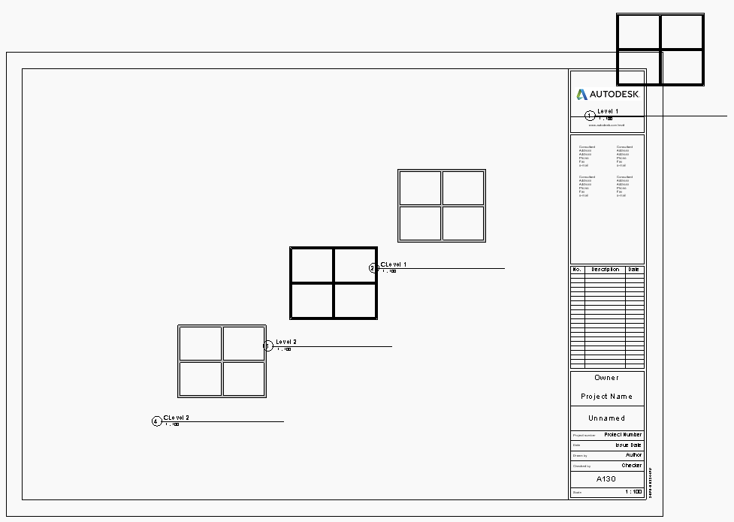
Viewport Location on Sheet
X,Y,Z
U Axis
1,1,0
1.5,1.5,0
V Axis
2,2,0
3,3,0

Slide 2
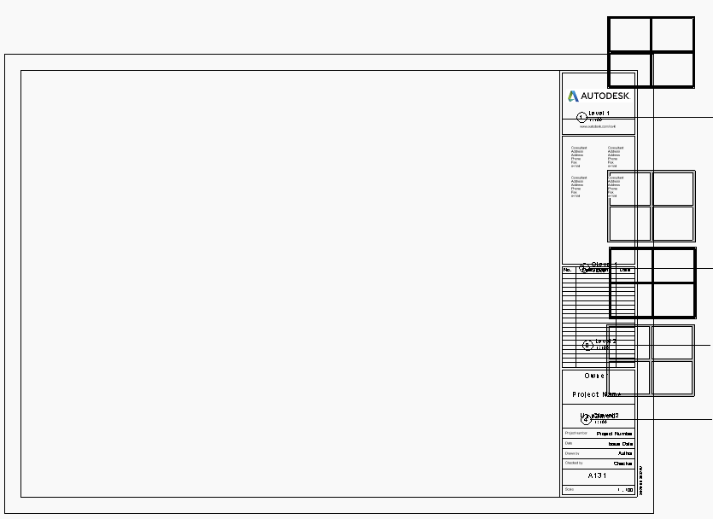
Viewport Location on Sheet
X,Y,Z
U Axis
1,1,0
1,1.5,0
V Axis
1,2,0
1,3,0

